Slide 1
HEAP
(DYNAMIC MEMORY ALLOCATOR)
BY SALWA ISHTIAQ

Slide 2
CONTENTS
INTRODUCTION
PROBLEM STATEMENT
SOLUTION- DIAGRAM
MEMORY ALLOCATION DIAGRAM
CODE IMPLEMENTATION
OUTPUT
LIVE DEMO

Slide 3
INTRODUCTION
WHAT IS HEAP IN OS ?
INTRODUCTION
PROBLEM STATEMENT
SOLUTION- DIAGRAM
MEMORY ALLOCATION DIAGRAM
CODE IMPLEMENTATION
OUTPUT
LIVE DEMO
A portion used for data that exist indeterminately or until explicitly deleted by programmer .
WHAT IS MEMORY ALLOCATOR?
Produces chunks of contiguous heap memory of requested size.
If no chunk of needed size is available, it increases the heap storage by getting consecutive bytes of virtual memory from OS.

Slide 4
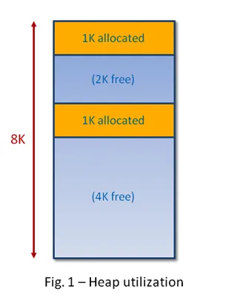
PROBLEM STATEMENT
Introduction
PROBLEM STATEMENT
SOLUTION- DIAGRAM
MEMORY ALLOCATION DIAGRAM
CODE IMPLEMENTATION
OUTPUT
LIVE DEMO
There is a critical need for an efficient memory management solution that can dynamically allocate and deallocate memory while minimizing fragmentation, ensuring thread safety, and addressing security concerns.

Slide 5
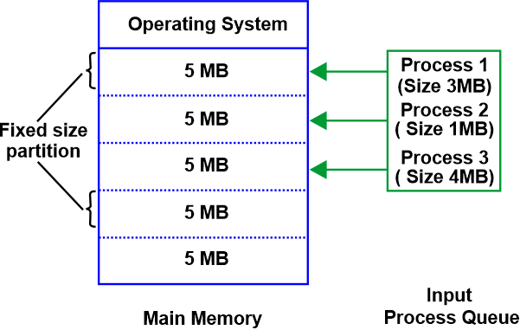
SOLUTION- DIAGRAM
Introduction
PROBLEM STATEMENT
SOLUTION- DIAGRAM
MEMORY ALLOCATION DIAGRAM
CODE IMPLEMENTATION
OUTPUT
LIVE DEMO

Slide 6
MEMORY ALLOCATION DIAGRAM
Introduction
PROBLEM STATEMENT
SOLUTION- DIAGRAM
MEMORY ALLOCATION DIAGRAM
CODE IMPLEMENTATION
OUTPUT
LIVE DEMO
30 byte
30 byte
30 byte
30 byte
30 byte
30 byte
30 byte
30 byte
Allocated
User
70 byte (Memory needed)
30 byte
30 byte
30 byte
1
1
1
1
1
-1

Slide 7
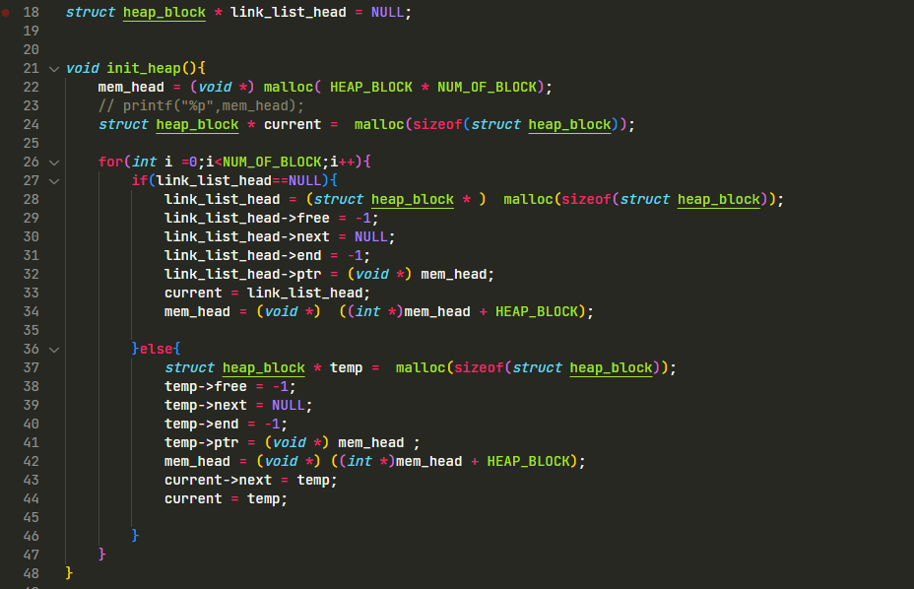
CODE
Introduction
PROBLEM STATEMENT
SOLUTION- DIAGRAM
MEMORY ALLOCATION DIAGRAM
CODE IMPLEMENTATION
OUTPUT
LIVE DEMO

Slide 8
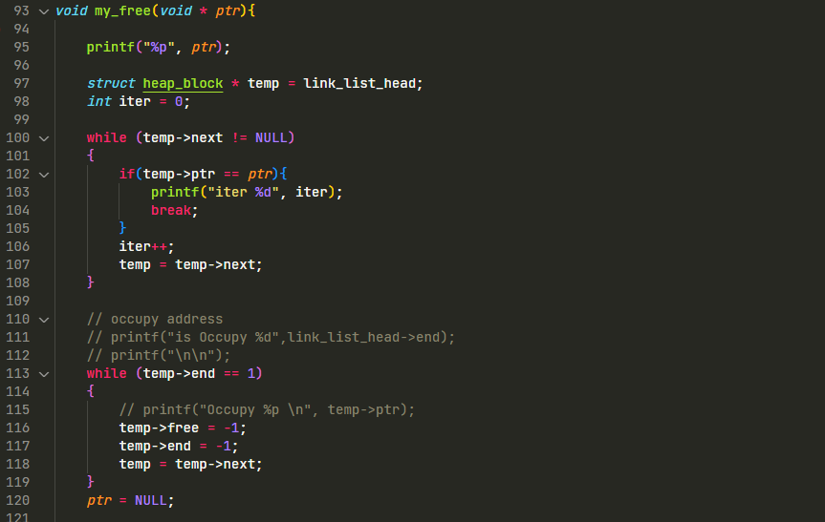
CODE
Introduction
PROBLEM STATEMENT
SOLUTION- DIAGRAM
MEMORY ALLOCATION DIAGRAM
CODE IMPLEMENTATION
OUTPUT
LIVE DEMO

Slide 9
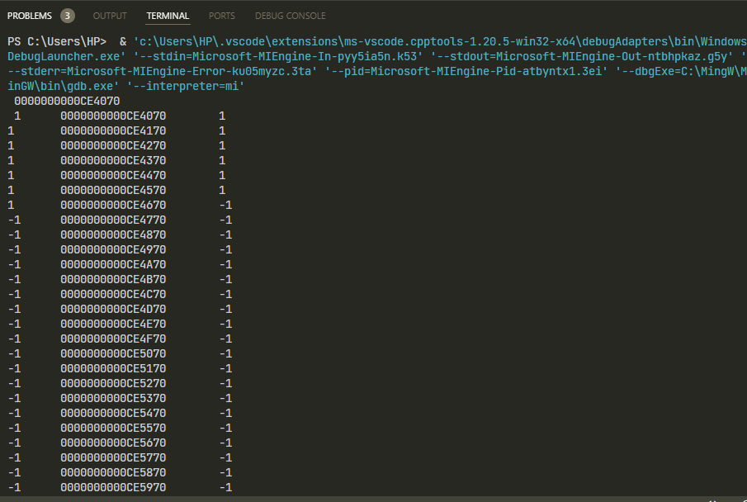
OUTPUT
Introduction
PROBLEM STATEMENT
SOLUTION- DIAGRAM
MEMORY ALLOCATION DIAGRAM
CODE IMPLEMENTATION
OUTPUT
LIVE DEMO

Slide 10
THANKYOU

